Slide 1
Malaria Disease Prediction
Team- 11 Team Members: Bhawna Priya
Bhavana V
Deeksha Udasi
Kavita Hegde
Reshma B

Slide 2
Problem Statement
Malaria remains a major burden on global health.
Besides biomedical research and political efforts, modern information technology is playing a key role in many attempts at fighting the disease.
One of the barriers to a successful mortality reduction has been inadequate malaria diagnosis in particular.
To improve diagnosis, image analysis software and machine learning methods have been used to quantify parasitemia in microscopic blood slides.

Slide 3
INTRODUCTION
Malaria is a deadly, infectious mosquito-borne disease caused by Plasmodium parasites.
These parasites are transmitted by the bites of infected female Anopheles mosquitoes.
Nearly half the world’s population is at risk from malaria and there are over 200 million malaria cases and approximately 400,000 deaths due to malaria every year.
This gives us all the more motivation to make malaria detection and diagnosis fast, easy and effective.

Slide 4
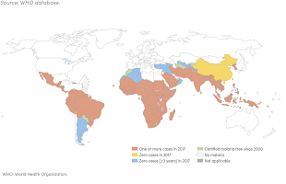
This is the Malaria Estimated Risk Heath Map by WHO.
It is pretty clear that malaria is prevalent across the globe especially in tropical regions.

Slide 5
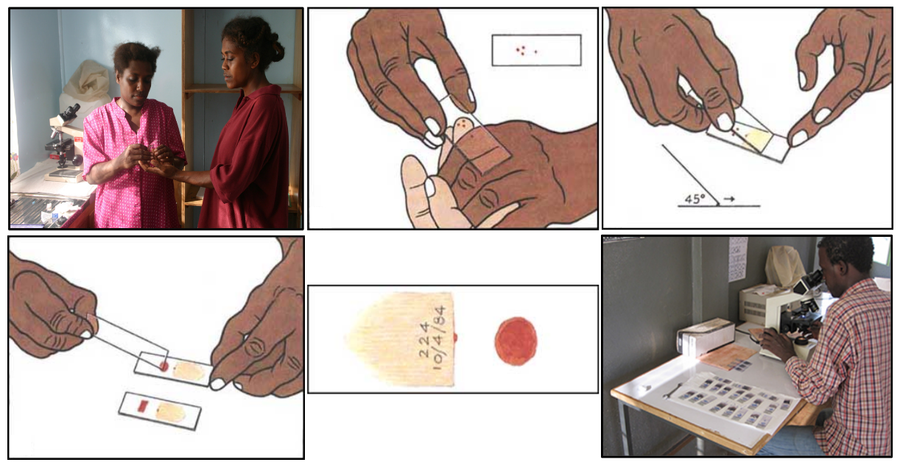
Methods for Detecting Malaria
There are several methods and tests which can be used for malaria detection and diagnosis including thick and thin blood smear examinations, polymerase chain reaction (PCR) and rapid diagnostic tests (RDT).
Based on the guidelines from the WHO protocol, this procedure involves intensive examination of the blood smear at a 100X magnification, where people manually count red blood cells that contain parasites out of 5000 cells.
A blood smear workflow for Malaria detection

Slide 6
Thus, malaria detection is definitely an intensive manual process which can perhaps be automated using deep learning which forms the basis of this project.
Deep Learning for Malaria Detection:
With regular manual diagnosis of blood smears, it is an intensive manual process requiring proper expertise in classifying and counting the parasitized and uninfected cells. Typically this may not scale well and might cause problems if we do not have the right expertise in specific regions around the world.
Deep Learning models, or to be more specific, Convolutional Neural Networks (CNNs) have proven to be really effective in a wide variety of computer vision tasks.
Our focus would be to try out simple CNN model from scratch to see the kind of results we get on the malaria dataset. We will be using open-source tools and frameworks which include Python and TensorFlow to build our models.

Slide 7

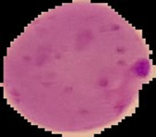
Dataset
In this paper, the dataset we used is derived from https://www.kaggle.com/iarunava/cellimages-for-detecting-malaria. Malaria dataset contains 27,558 cell images classified into two groups called parasitized and uninfected cells, where each cell contains an equal number of instances.
Then we are splitting it into test_set and train_set with 80-20 split.
Uninfected Cell
Parasitized Cell

Slide 8
Software Designing
Jupyter Notebook Environment / Google Colab
Spyder IDE
Deep Learning Algorithms (CNN)
Python ( numpy, matplotlib, ImageDataGenerator, keras)
HTML
CSS
JavaScript
Flask

Slide 9
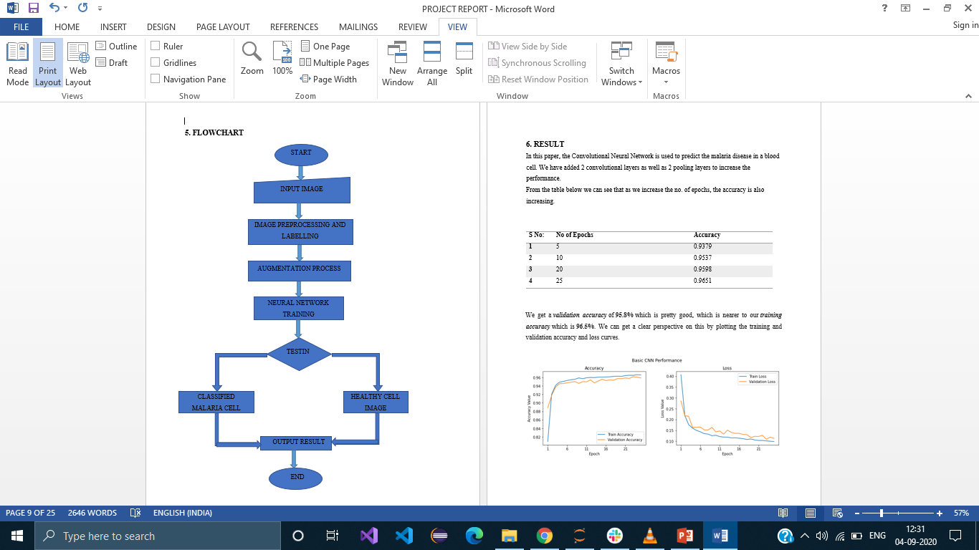
Flowchart

Slide 10
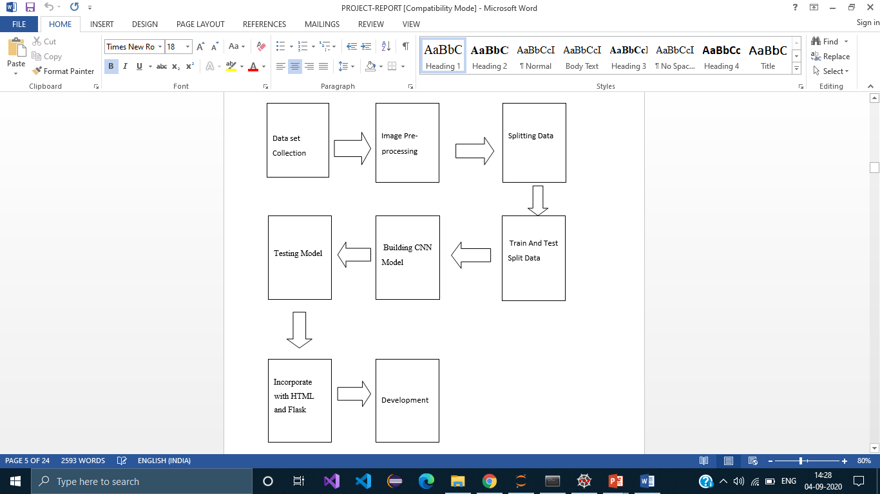
Block Diagram

Slide 11
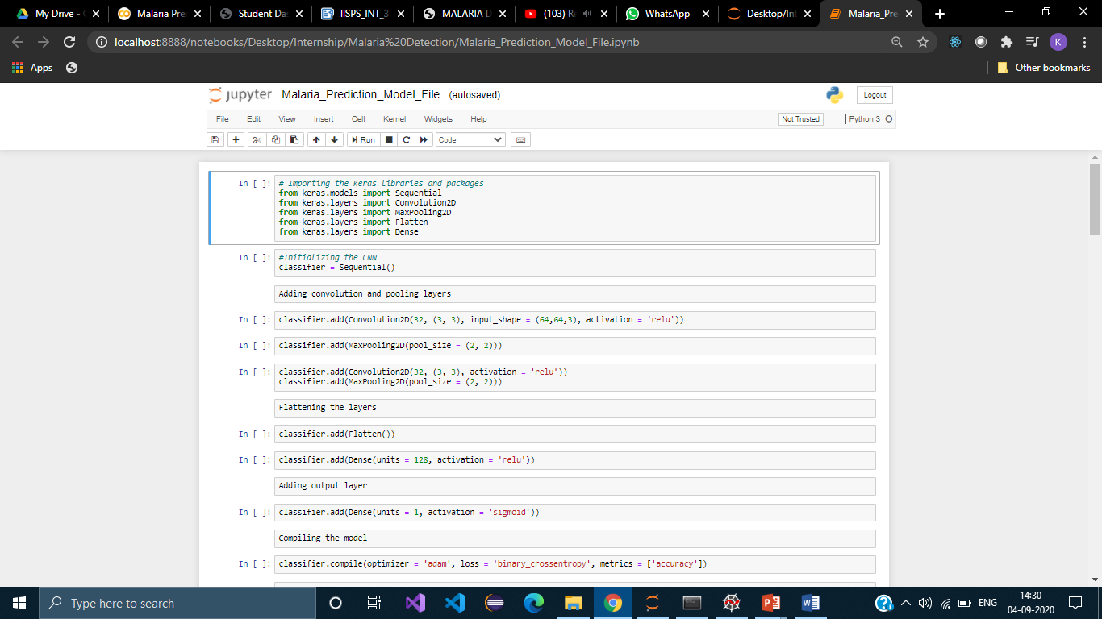
Model Code

Slide 12
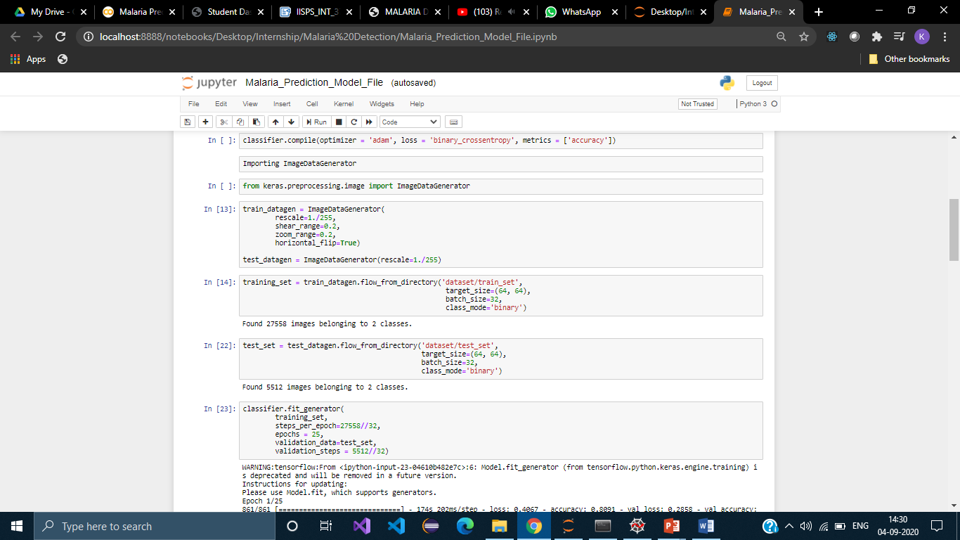

Slide 13
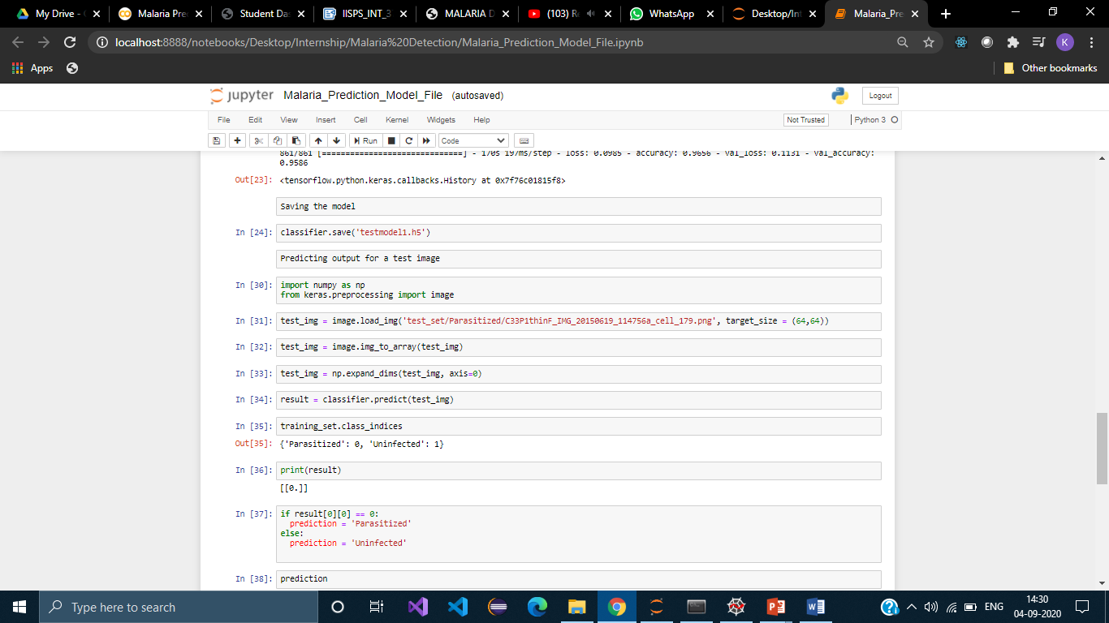

Slide 14
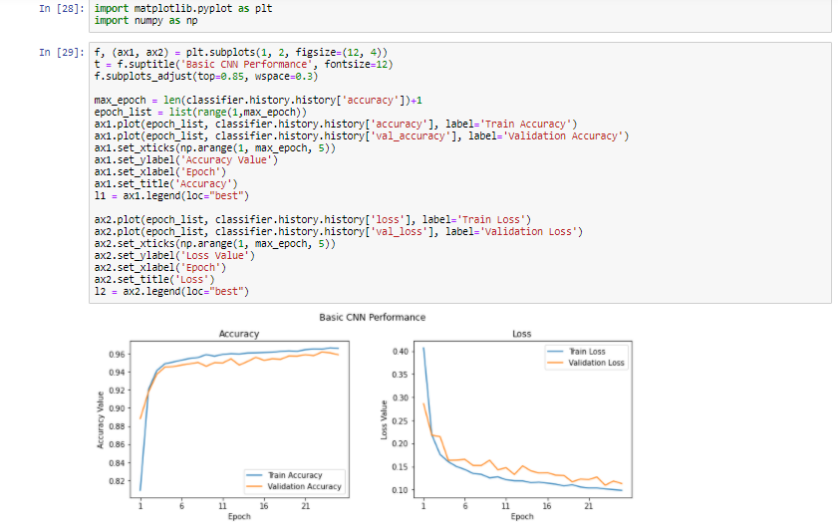

Slide 15
Result
In this project, Convolutional Neural Network is used to predict the malaria disease in a blood cell. We have added 2 convolutional layers as well as 2 pooling layers to increase the performance.
From the table below we can see that as we increase the no. of epochs, the accuracy is also increasing.
S No: | No of Epochs | Accuracy | Value Accuracy
1 | 5 | 0.9379 | 0.9455
2 | 10 | 0.9537 | 0.9499
3 | 20 | 0.9598 | 0.9557
4 | 25 | 0.9651 | 0.9586

Slide 16
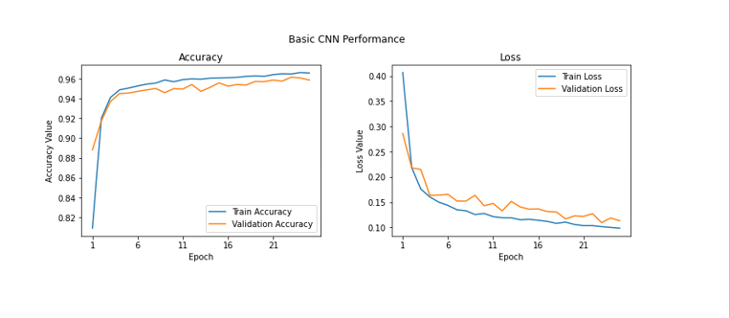
Accuracy
We get a validation accuracy of 95.8% which is pretty good, which is nearer to our training accuracy which is 96.5%. We can get a clear perspective on this by plotting the training and validation accuracy and loss curves.

Slide 17
ADVANTAGES AND DISADVANTAGES
Advantages:
It can easily identify the parasitized or uninfected blood cell.
It can work in real time and predict as soon as the necessary details for predictions are given to the model.
Disadvantages:
Gives only 0.9651 accuracy for the prediction of malaria status.
The calculation becomes incompatible because the shape of red blood cells is not perfect.

Slide 18
APPLICATIONS
Deep learning based model can detect malaria parasites from microscopic images with accuracy of 99.23% while requiring just over 4600 floating point operations
Malaria detection of drawing blood cells using the Opencv, which can detect malaria on patient through microscopic digital image of blood samples.
For practical validation of model efficiency, we have deployed the miniaturized model in a server-backend web application.

Slide 19
CONCLUSION
We looked at an interesting real-world medical imaging case study of malaria detection in this article.
We looked at easy to build open-source techniques leveraging AI which can give us state-of-the-art accuracy in detecting malaria thus enabling AI for social good.
Let’s hope for more adoption of open-source AI capabilities across healthcare making it cheaper and accessible for everyone across the world!

Slide 20
THANK YOU

